Slide 1
Introduction to Cryptography

Slide 2
One-way Hash Function
One-way hash function is a function that maps a long input into a short output, preserving the security.
<<Harry Porter>>
1402b512f06729dab40831b688ca0219

Slide 3
Properties of One-way Hash Function
One-way Hash Properties:
One-way: hash(m) = h, difficult to find m
Collision resistant: Difficult to find m1 and m2 s.t. hash(m1) = hash(m2)
Common One-way Hash Functions:
MD series
SHA series

Slide 4
MD One-Way Hash Functions
MD stands for Message Digest
Developed by Ron Rivest
Includes MD2, MD4, MD5,and MD6
Status of Algorithms:
MD2, MD4 - severely broken (obsolete)
MD5 - collision resistance property broken, one-way property not broken
MD6 - developed in response to proposal by NIST

Slide 5
SHA
Published by NIST
Includes SHA-0, SHA-1, SHA-2, and SHA-3
Status of Algorithms:
SHA-0: withdrawn due to flaw
SHA-1: Collision attack found in 2017
SHA-2: Includes SHA-256 and SHA-512; No significant attack found yet
SHA-3: Released in 2015; Has different construction structure

Slide 6
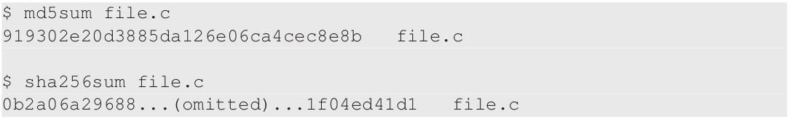
One-Way Hash Commands
Linux utility programs
Example: md5sum, sha224sum, sha256sum, sha384sum and sha512sum

Slide 7
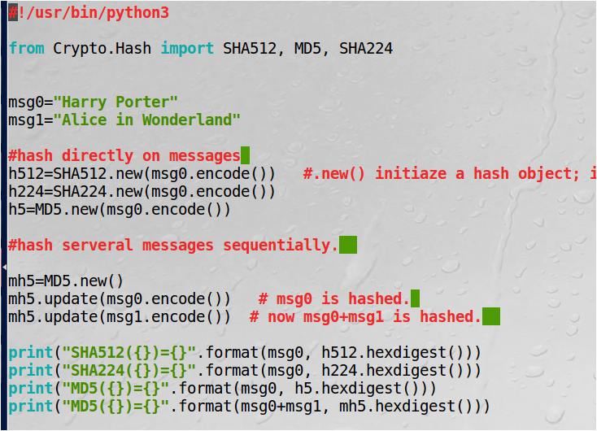
Hash programming using Python package PyCryptodome: https://pycryptodome.readthedocs.io/en/latest/src/api.html
Initialize hash object

Slide 8
Password Verification
To login into account, user needs to tell a secret (password)
Cannot store the secrets in their plaintext
Solution: Linux stores hashed passwords in the /etc/shadow file
When you provide the password, the system will hash and check the result is identical to the system storage.

Slide 9
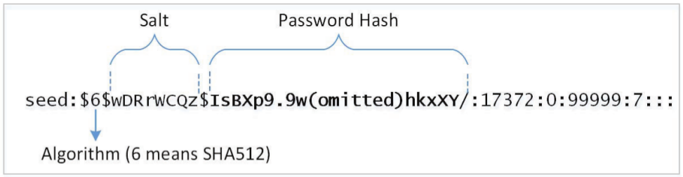
Case Study: Linux Shadow File
Password field has 3 parts: algorithm used, salt, password hash
Salt and password hash are encoded into printable characters

Slide 10
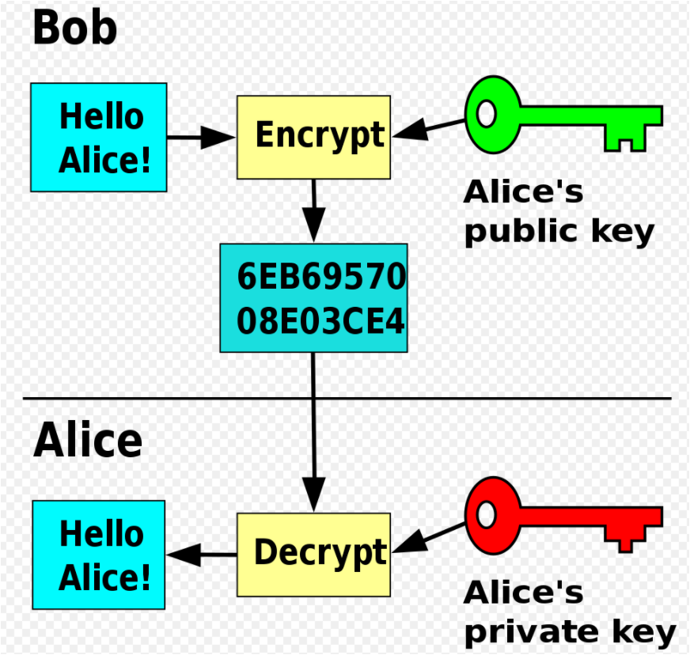
Public Key Cryptosystem
Private Key cryptography: shared key for encryption and decryption
1976: Diffie and Hellman: a notion of public-key encryption
1978: Rivest, Shamir, and Adleman: RSA public key encryption

Slide 11
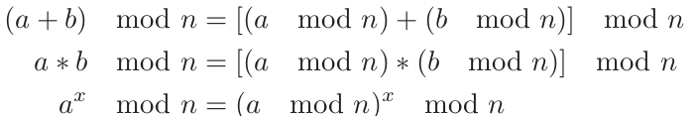
Modulo Operation
a mod n: the remainder after a divided by n
n is called modulus
Ex. 10 mod 3 = 1 and 15 mod 5 = 0
Remember: +, * and exponentiations under mod n can be done the same way as if no mod n is used.
Important: when you do mod n operation does not affect the result.

Slide 12
Modulo Operation: example
(3+18) mod 7=21 mod 7=0
(3+18) mod 7=3+ 18mod7=3+4 mod 7=0.
3*8 mod 5=24 mod 5 =4 and 3* 8 mod 5 =3*3 mod 5=9 mod 5 =4.
2⁸mod 12=256 mod 12=4
2⁸ mod 12 =2⁴*2⁴ mod 12=4*4 mod 12=4

Slide 13
RSA Cryptosystem
We will cover:
Key generation
Encryption
Decryption

Slide 14
RSA: Key Generation
Need to generate: modulus n, public key e, private key d
Procedure:
Choose large primes p,q
n = pq
Choose odd e< n (e.g., e=65537)
Find d s.t. ed mod (p-1)(q-1) = 1 (Euclidean Algoithm)
Result
(e,n) is public key
d is private key
ed= k (p-1)(q-1)+1 for some k

Slide 15
RSA: Encryption and Decryption
Encryption
treat the plaintext as a number
assume M < n
C = Me mod n
Decryption
M = C^{d} mod n

Slide 16
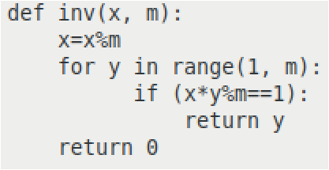
RSA Exercise: Small Numbers
Choose two prime numbers p = 13 and q = 17
Find e:
n = pq = 221
(p − 1)(q − 1) = 192
choose e = 7
Find d:
ed = 1 mod (p-1)(q-1)
7d = 1 mod 192
d = 55 (Euclidean algorithm, omitted)
d=inv(e, (p-1)(q-1))

Slide 17
RSA Exercise: Small Numbers (Contd.)
Encrypt M = 36:
C=36e mod n=pow(36, e, n) =179 (in python)
Cipher text ( C ) = 179 :
M=179^{d} mod n=pow(179, d, n)=36 (in python)

Slide 18
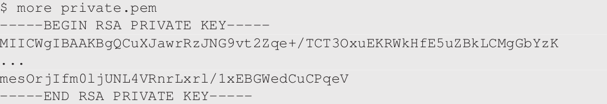
OpenSSL Tools: Generating RSA keys
Example: generate a 1024-bit public/private key pair
openssl genrsa -aes128 -out private.pem 1024
private.pem: Base64 encoding of DER generated binary output

Slide 19
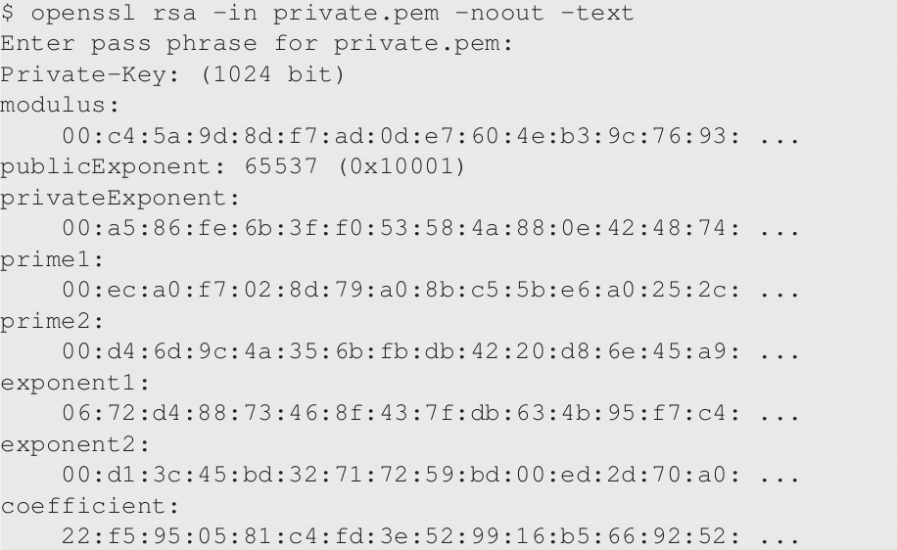
OpenSSL Tools: Generating RSA keys (Contd.)
Actual content of private.pem

Slide 20
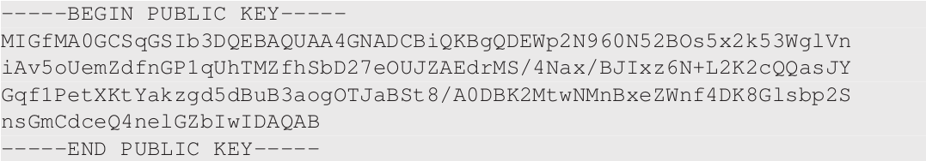
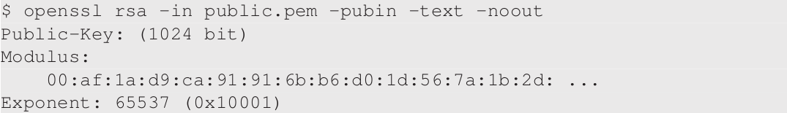
OpenSSL Tools: Extracting Public Key
openssl rsa -in private.pem -pubout > public.pem
Content of public.pem:

Slide 21
Programming using Public-Key Crypto APIs
Python:
use Python package PyCryptodome: https://pycryptodome.readthedocs.io/en/latest/src/api.html
We will cover:
Encryption and Decryption
Digital Signature
AES

Slide 22
Public-Key Cryptography APIs: Encryption
There are different implementations of RSA
For better security, it is recommended that OAEP is used
Lines in code (example on next slide):
Line (1): import the public key from the public-key file
Line (2): create a cipher object using the public key

Slide 23
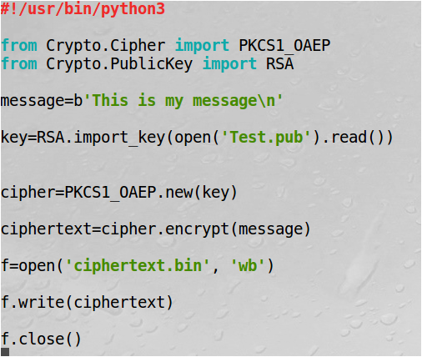
Public-Key Cryptography APIs: Encryption
encrypt_RSA.py
RSA encrypt/decrypt function
RSA key function
Convert key in byte string to key object
Initialize cipher object (with key)
cipher object has encrypt/decrypt functions

Slide 24
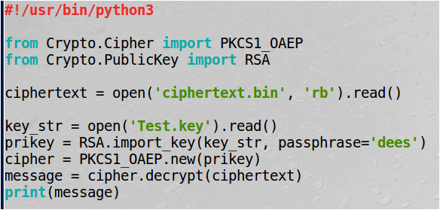
Public-Key Cryptography APIs: Decryption
Uses the private key and the decrypt() API
decrypt_RSA.py
Convert key string to key object:
need password

Slide 25
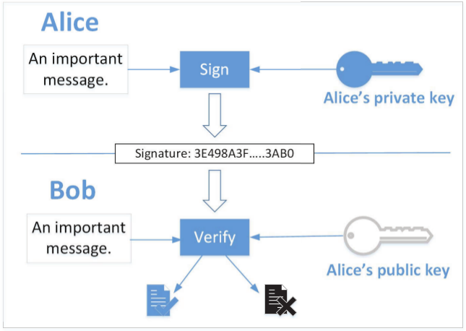
Digital Signature
Goal: provide an authenticity proof by signing digital documents
Idea: private key to sign and every body can verify using public key.

Slide 26
Digital Signature using RSA
The RSA signature for message m can be defined as
Digital signature s= m^{d} mod n
Verification: s^{e}=m mod n?
why correct: s^{e}=m^{de}=C^{d}=m mod n (RSA decryption)
However, m and m+n has the same signature, not good!
Actual signature: s=H(m)^{d} mod n for a hash function H.
Verification: s^{e}=H(m) mod n?
H can be MD5, Sha256, Sha512, etc.

Slide 27
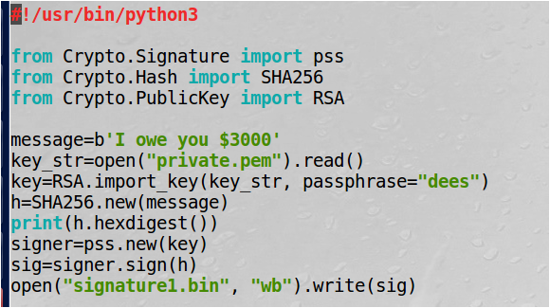
Python Digital Signature using PSS: sign
sign_RSA.py
Signature function
Signature object
Signature object has sign/verify functions

Slide 28
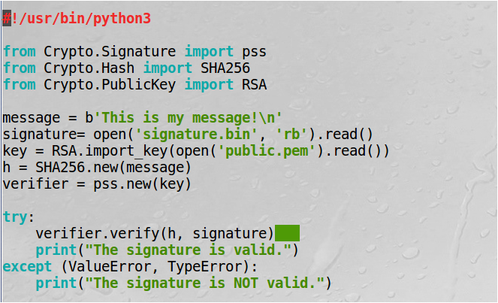
Python Digital Signature using PSS: verify
verify_RSA.py

Slide 29
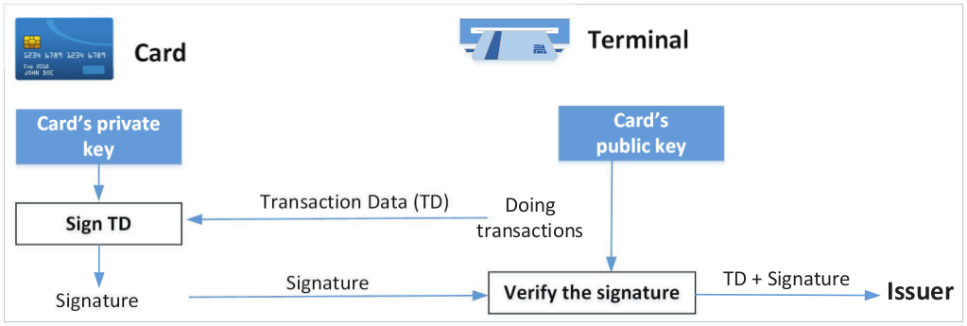
Applications: Credit Card Authentication
Credit card company needs to know if the transaction is authentic
Transaction needs to be signed by the card using its private key
Verified Signature:
To issuers: card owner has approved the transaction
To honest vendor: enables the vendor to save the transactions and submit them to credit card company later

Slide 30
Hybrid Encryption
High computation cost of public-key encryption
Public key algorithms used to exchange a secret session key
Key (content-encryption key) used to encrypt data using a symmetric-key algorithm. Example:
K^{e} mod n, AES_{k}(b’This is my secret’)

Slide 31
Advanced Encryption Standard (AES)
AES is a block cipher
128-bit block size: plaintext 128 bits----- > ciphertext 128 bits.
Three different key sizes: 128, 192, and 256 bits

Slide 32
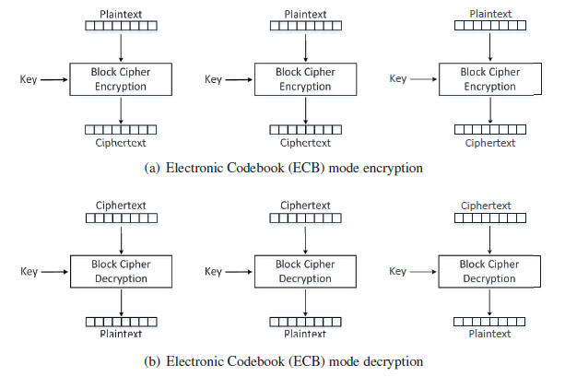
Electronic Codebook (ECB) Mode

Slide 33
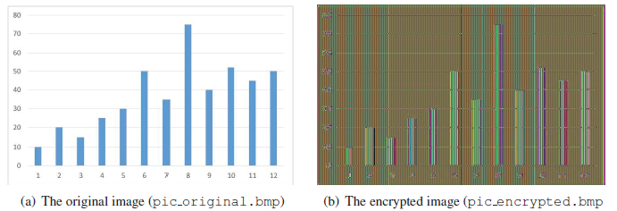
ECB is not enough for file encryption
plaintext

Slide 34
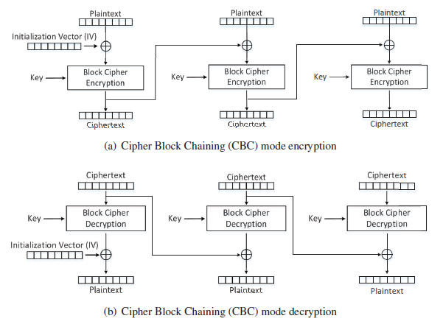
Cipher Block Chaining (CBC) Mode
With different IVs, a plaintext file will encrypt to completely different ciphertext files.
Previous blocks affect ciphertexts of subsequent blocks.
Problem for ECB is avoid

Slide 35
Padding
The encryption is block-by-block. E.g., block-size=128-bit in AES-128
If plaintext Mis 120-bit, then it should be padded with 8 bit to make a block. This is called plaintext padding.
You can not simply add 00000000 to M because receiver can not know the message is M or M0 or M00 or ….

Slide 36
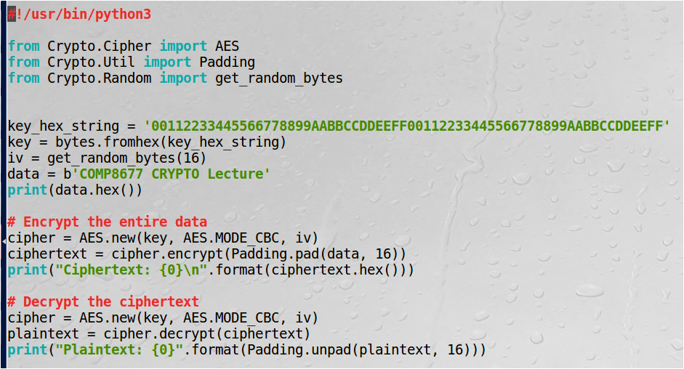
Programming using Crypto APIs
endec_AES.py
Line:
Initialize cipher
Encrypt the entire data with padding, blocksize=16bytes
Initialize cipher for decryption
Decrypt (without unpadding)
①
②
③
④

Slide 37
Diffie-Hellman Key Exchange
Alice and Bob want to share a secret key K.
They know public parameters:
Big prime number p
A number g<p (e.g., g=2).

Slide 38
Diffie-Hellman key exchange
p, g: public
x
y
g^{x} _{mod p}
g^{y} mod p
sk=(g^{y})^{x} mod p
sk=(g^{x})^{y} mod p
Discrete Logarithm Assumption:
g^{x} mod p=====hard==== > x.

